Slide 1
CONVERSION OF GESTURES TO VOICE AND TEXT MESSAGE IN REGIONAL LANGUAGE
TEAM MEMBERS:
MENAKA.S (211417104146)
PREETHI.P (211417104199)
SHESHADRI ROSHNI SRUTHI (211417104257)
GUIDE NAME:
MRS.V.SATHYA PREIYA
SUPERVISOR

Slide 2
INTRODUCTION
Hand gestures as human-machine interface .
Principles - hand gesture recognition are based on traditional algorithms .
The more concrete situations exists for human-machine interaction .
Methods – Pre processing , Feature extraction , Real time classification

Slide 3
LITERATURE SURVEY
S.NO | TITLE OF THE PAPER | YEAR | PUBLICATION | DESCRIPTION | LINK OF THE PAPER
1 | HAND GESTURE RECOGNITION AND VOICE CONVERSION SYSTEM FOR DUMP PEOPLE | 2019 | International Research Journal of Engineering and Technology | Hand Gesture to voice in English . | http://www.jetir.org/papers/JETIRBC06024.pdf
2 | HAND GESTURE RECOGNITION AND VOICE CONVERSION FOR DEAF AND DUMB | 2018 | 5th International Conference on Advanced Computing & Communication Systems | Non-vision based technique. Sign language to human hearing voice. | https://www.irjet.net/archives/V5/i4/IRJET-V5I4308.pdf
3 | SMART GLOVES FOR HAND GESTURE RECOGNITION: SIGN LANGUAGE TO SPEECH CONVERSION SYSTEM | 2016 | International Conference on Robotics and Automation for Humanitarian Applications | Smart glove ,sign language to speech output. | https://www.researchgate.net/publication/317129387_Smart_gloves_for_hand_gesture_recognition_Sign_language_to_speech_conversion_system

Slide 4
PROBLEM STATEMENT
About billion people in the world are deaf and dumb.
Communication between people is challenging
Sign language helps deaf and dumb people to communicate.
But not all people understand sign language.
Objective - Achieve communication of DUMB people.
Reduce cost and improve robustness using simple web camera.

Slide 5
TECHNOLOGY STACK
HARDWARE REQUIREMENTS
Desktop / Laptop
GB RAM
Keyboard
Mouse
Windows 7 +
Pentium IV +
SOFTWARE REQUIREMENTS
Python
IDLE
Anaconda
Jupyter Notebook

Slide 6
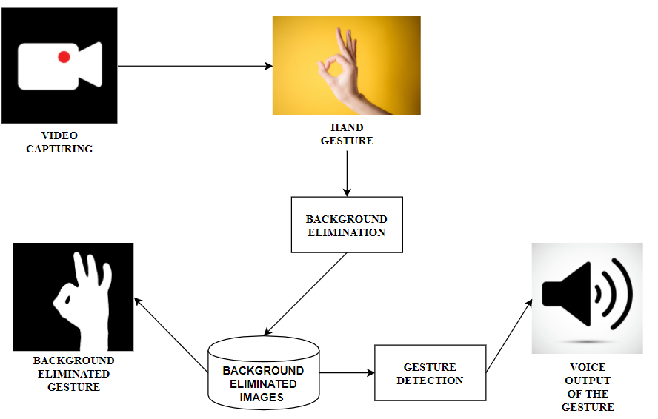
SYSTEM ARCHITECTURE

Slide 7
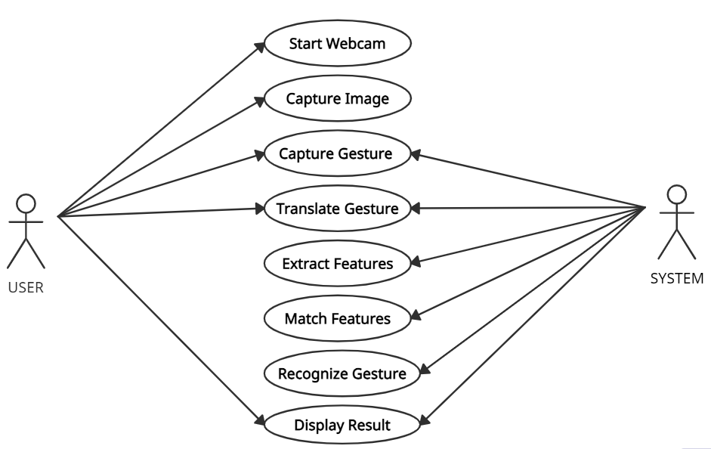
USE CASE DIAGRAM

Slide 8
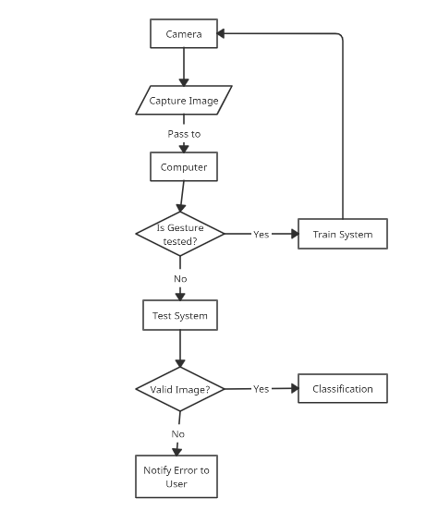
FLOW CHART

Slide 9
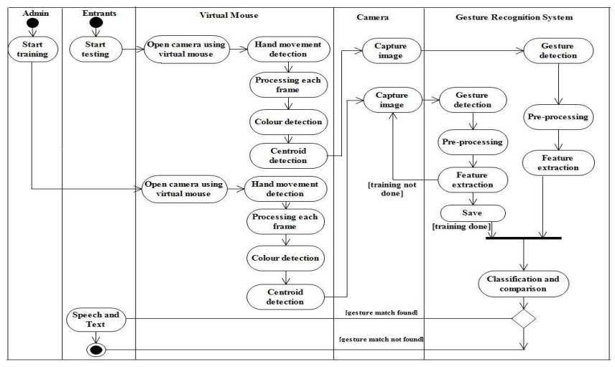
ACTIVITY DIAGRAM

Slide 10
MODULES
Dataset collection
Dataset pre-processing
Machine Learning Training
Capture Real time video
Eliminate Background
Identify Gesture

Slide 11
DATASET COLLECTION:
Dataset collection involves collecting or creating test dataset for gesture and respective terminology. This is very exhaustive task as we need to collect more samples for gesture. We collect dataset from kaggle website for the project in scope.
DATASET PRE-PROCESSING:
Dataset preprocessing involves removing noise in images and converting to numpy arrays
MACHINE LEARNING:
Machine learning involves training and classification using CNN algorithms.

Slide 12
CAPTURE REAL TIME VIDEO & GESTURE DETECTION:
We use opencv to capture and process video. Here we capture video and pre-process frames and fit in model to get the gesture
BACKGROUND ELIMINATION:
We will find the contours to detect edges of the main object and create a mask with numpy zeros for the background and then combine the mask and the image using bitwise and operator.

Slide 13
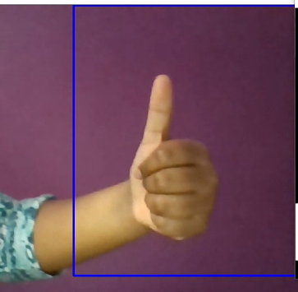

DATASET
LINK:
https://www.kaggle.com/flintytub49/hand-gestures-black-and-white
Normal Trained

Slide 14
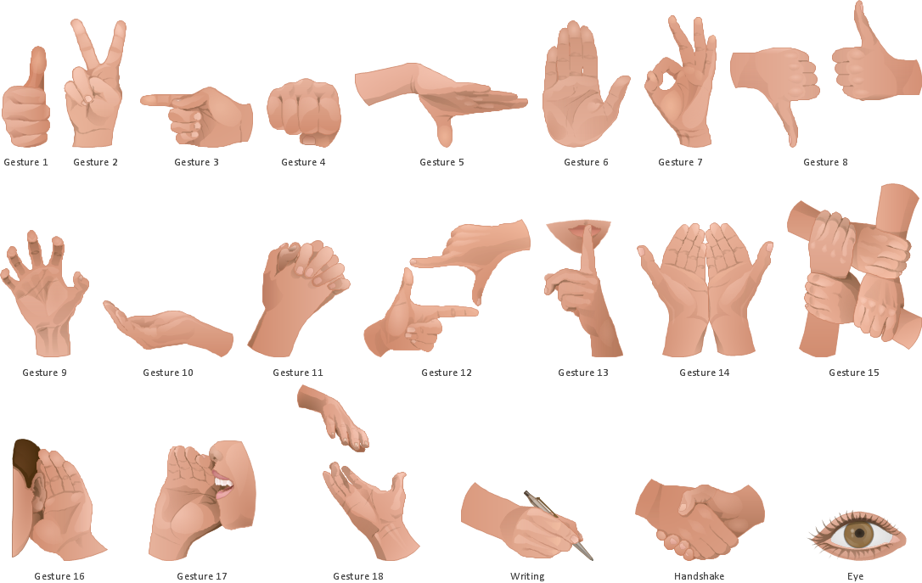
DIFFERENT TYPES OF GESTURES

Slide 15
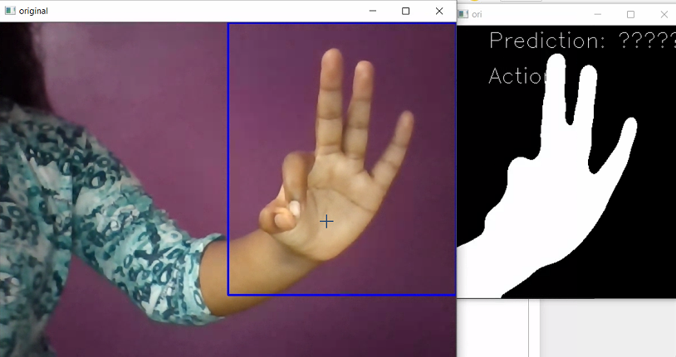
RESULTS

Slide 16
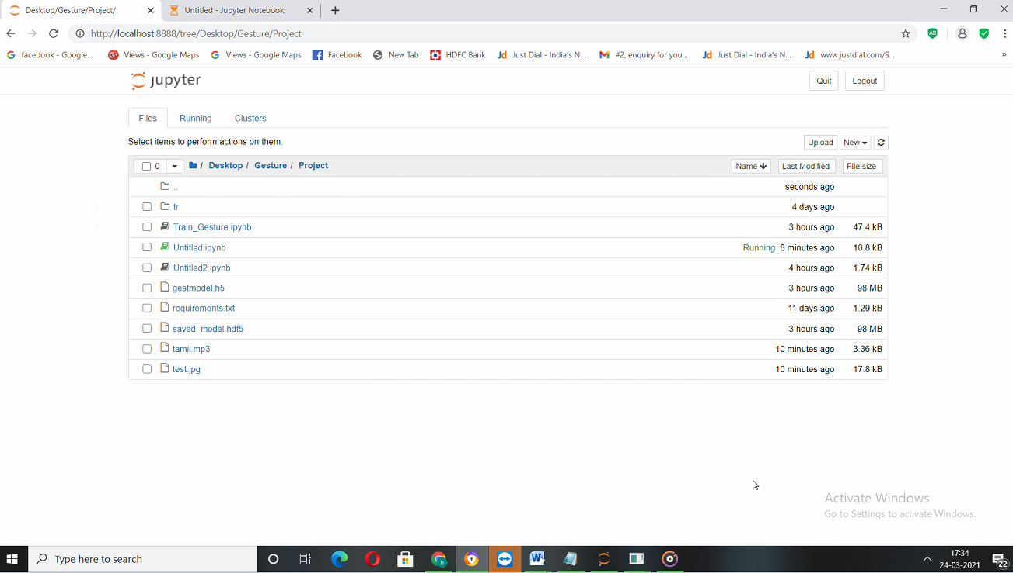
SCREEN SHOTS

Slide 17
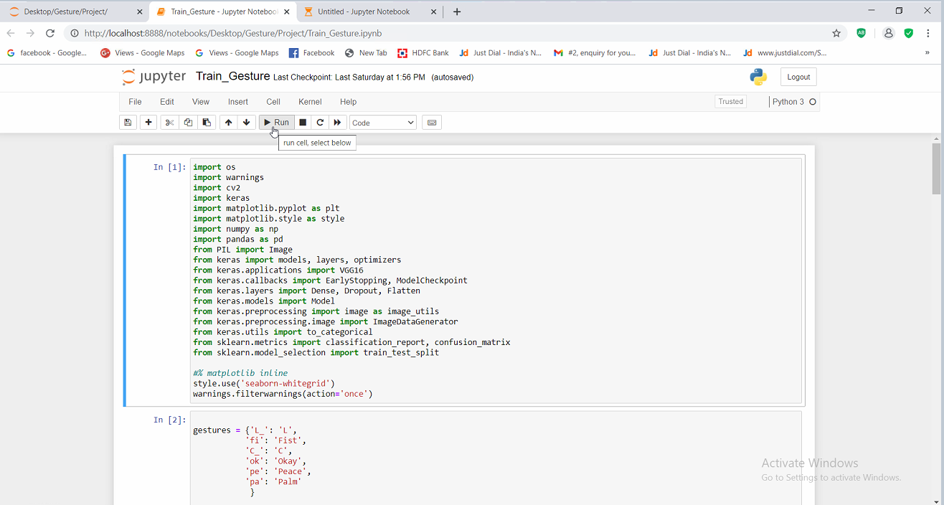

Slide 18
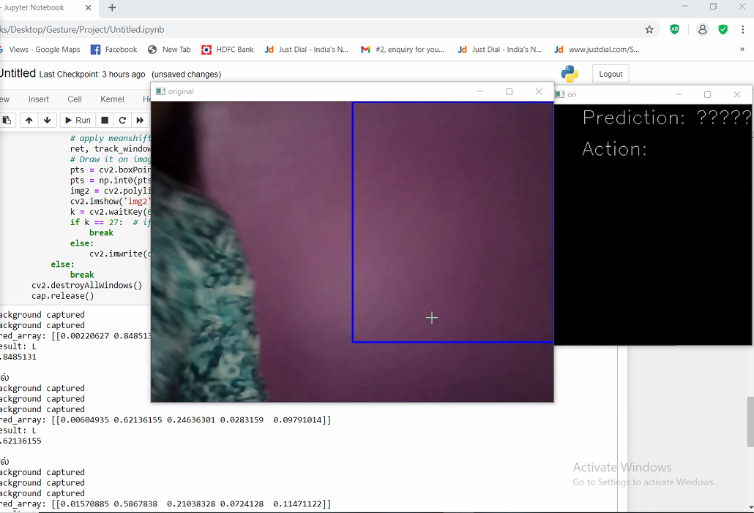

Slide 19
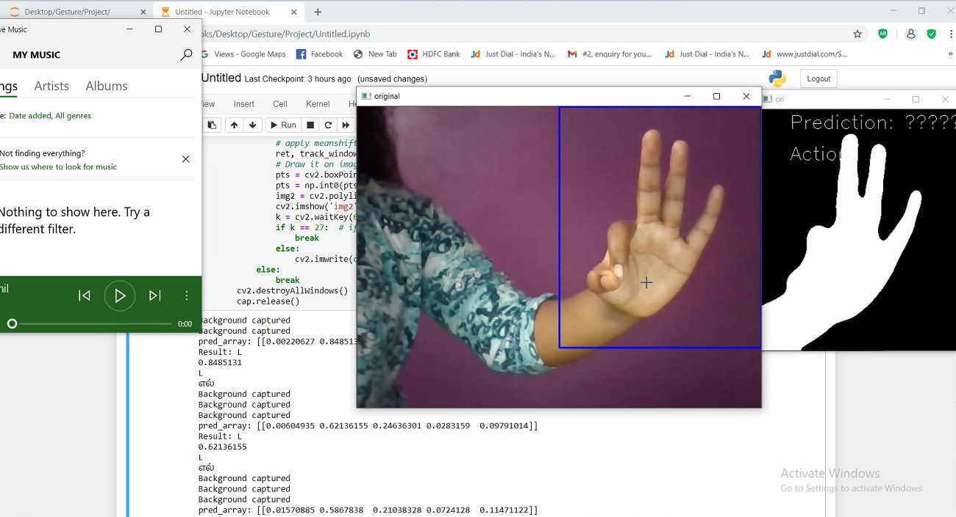

Slide 20
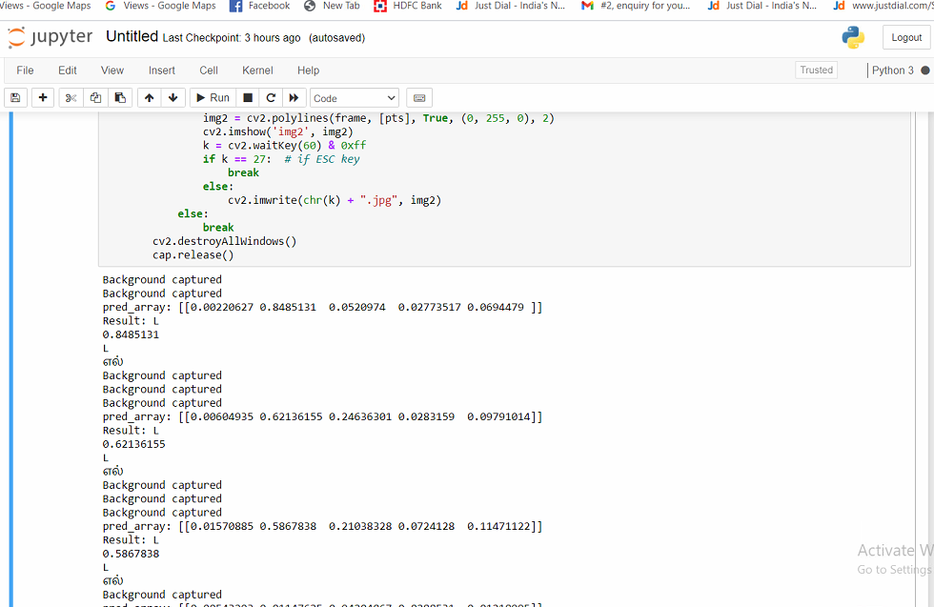

Slide 21
CONCLUSION
Achieve real time gesture recognition with Indian Sign Language.
Multiple versions of datasets, trained models with high accuracy.
Train any gesture recognition application and other steps remain the same.
Satisfaction for Dumb people.

Slide 22
FUTURE ENHANCEMENT
Here we add only few dataset, later in future it can be added more.
It is not that efficient to work with all skin type and light conditions, in further it is also possible in future.
Speed for pre-processing could be improved if the code is developed in vc/vc.net.

Slide 23
REFERENCE
Pr. Kale, “Hand gesture recognition for human-computer interaction,” International Journal of Scientific Development and Research (IJSDR), Volume 1, Issue 8, pp.9- 14, August 2016.
T. Fujii, and J. H. Lee, “Gesture Recognition System for Human-Robot Interaction and Its Application to Robotic Service Task,” Proceedings of the International Multi Conference of Engineers and Computer Scientists (IMECS 2014), Vol 1, March 12 - 14, 2014, Hong Kong.
H. Tang, H. Liu, W. Xiao, and N. Sebe1,“Fast and Robust Dynamic Hand Gesture Recognition via Key Frames Extraction and Feature Fusion, ”Preprint submitted to Neuro Computing, January 2019. https://arxiv.org/pdf/1901.04622.pdf.
N. Ibraheem, and R. Khan, “Survey on Various Gesture Recognition Technologies and Techniques,” International Journal of Computer Applications, Vol. 50, No.7, pp. 38-44, July 2012.
Ok. Kopuklu, Ah. Gunduz1, N. Kose, and G. Rigoll, “Realtime Hand Gesture Detection and Classication Using Convolutional Neural Networks,” Accepted to IEEE International Conference on Automatic Face and Gesture Recognition FG 2019, France, 14 -18 May 2019.
N. Singla, “Motion Detection Based on Frame Difference Method,” International Journal of Information & Computation Technology, ISSN 0974-2239, Vol. 4, Number 15, pp. 1559-1565,2014.
R. A. Elsayed, M. S. Sayed, and M. I. Abdalla, “Skin-based adaptive background subtraction for hand gesture segmentation,” IEEE International Conference on Electronics, Circuits, and Systems (ICECS), Cairo, Egypt, 6-9 December.
Surveyor SRV-1 Blackfin Robot. http://www.surveyor.com/SRV_info.html.
D. L. Poole, and A. K. Mackworth, “Python code for Articial Intelligence: Foundations of Computational Agents,” https://artint.info/AIPython/aipython.pdf [10] Hand gesture images database. https://aws.amazon.com.

Slide 24
THANK YOU

